Slide 1
Healthcare Patient Feedback Sentiment Analysis
BDM 1034 – Application Design for Big Data 01
GROUP 5

Slide 2
Team Members
Ajay Kumar C0942384
Sudip Shrestha
C0934400
Prabhakar Thapa C0938971
Armaan Verma C0935308
Hargun Singh Lamba C0938310
Shriya Upadhyay C0938089
Dilip Bahadur Chhetri
C0938972
Pooja Shrestha
C0931754
Sneh Pathak C0938327

Slide 3
Introduction
Automated tool to analyze patient sentiment, improving quality and satisfaction.

Slide 4
How Healthcare Industry Works?
Patient-Centric Approach
Sentiment Analysis Impact
Research Insight

Slide 5
Problem Statement
Current Challenges: Manual Feedback Analysis is inconsistent and time-consuming. Large volumes of Social media feedback remain unutilized.
Overlooked patient concerns, lower patient satisfaction and reduced patient retention.

Slide 6
Why US?

Slide 7
01
02
03
Differentiation from Existing Solution?
Social Media Focus
Healthcare Specific Adaptation
Real Time Dashboard

Slide 8
Flow Diagram
Data Collection (Reddit, Twitter, Kaggle)
Data Storage & Processing
Data Visualization
Dashboard & End-Result
Sentiment Analysis Model

Slide 9
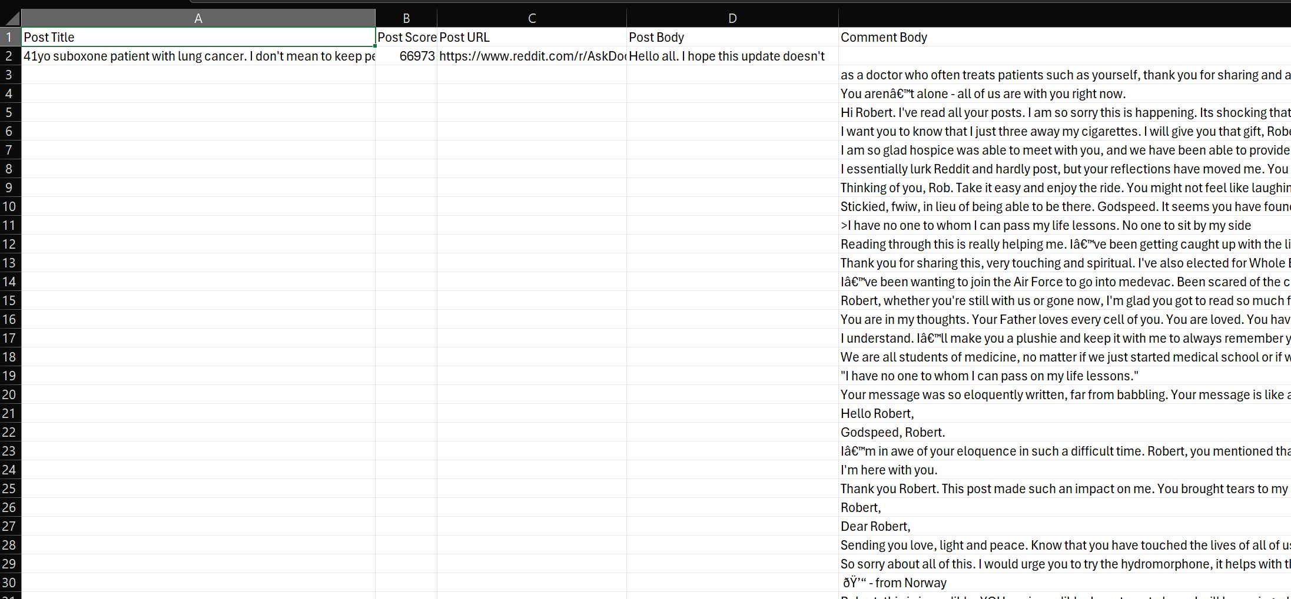
Data Gathering
Sample Dataset
Dataset Description
Data Collection
Data Characteristics
Existing Dataset
(To Test & Train)
1.6 Million Records

Slide 10
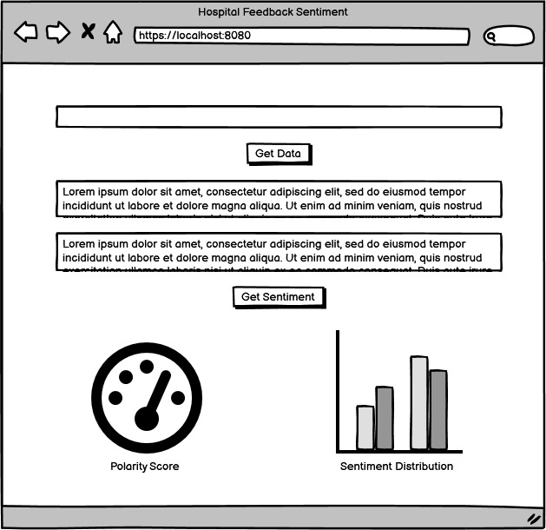
Wireframe

Slide 11
Thank you :))
Any Questions?

